Slide 1
HANDS-ON LABS

Slide 2
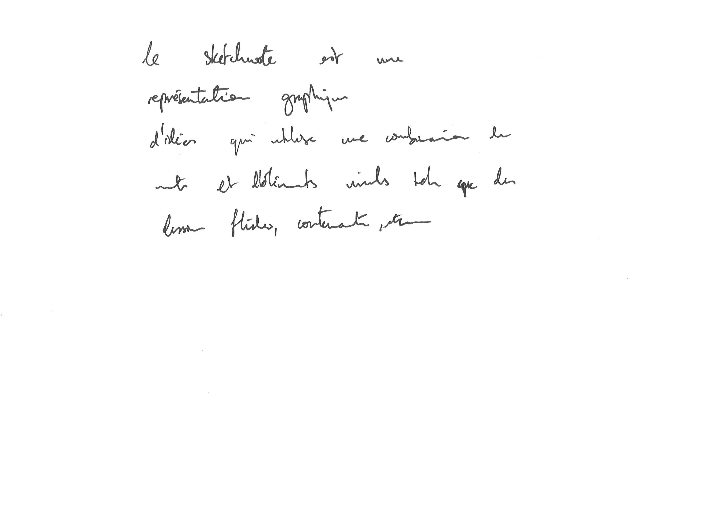

Slide 3
